Slide 1

UE20CS390B – Capstone Project Phase – 2
SEMESTER - VII
END SEMESTER ASSESSMENT
Project Title : Deploy microservices on Kubernetes Cluster and Improve Scalability using Custom Scheduler
Project ID : PW_23_VP_01
Project Guide : Prof Venkatesh Prasad, Mr. Vijay R(EOX Vantage)
Project Team : Veena Garag PES1UG20CS492
Adarsh Kumar PES2UG20CS016
Suchit S Kallapur PES1UG20CS438
Yuvaraj D C PES1UG20CS521

Slide 2
Team Roles and Responsibilities
Deploy microservices on kubernetes cluster and improve scalability using custom scheduler
Yuvaraj dc | created kubernetes cluster and setup monitoring tools. deployed mongodb-express application on server instance and exposed it to public.
Veena Garag | Implementation of custom scheduler and demonstration using nginx application. Comparison between default KHPA and custom scheduler.
Suchit S Kallapur | worked on setting up prometheus and grafana using helm charts
Adarsh Kumar | Worked on testing, monitoring tools - locust and kiali. Setup of Matrix Server for Custom Controller.

Slide 3
Summary of Requirements and Design
Deploy microservices on kubernetes cluster and improve scalability using custom scheduler
Deploying microservices on Kubernetes cluster.
To be able to handle large user at a time.
Use minimal resources as much as possible.
Spin up and spin down of the microservices based on the number of users using the application.
Implement Kubernetes monitoring and logging using tools such as Prometheus, Grafana.

Slide 4
Design Constraints & Dependencies
Deploy microservices on kubernetes cluster and improve scalability using custom scheduler
Constraints:
Resource Availability: Availability of adequate hardware resources, such as CPU, memory, and storage, can limit the application's scalability.
Dependencies:
Kubernetes: The project relies on Kubernetes as the underlying container orchestration platform for managing microservices deployments.
Istio Mesh Networks: Istio provides service-to-service communication and visibility, enhancing application observability and control.
Kiali and Prometheus: Kiali and Prometheus are employed for comprehensive monitoring of microservices, collecting metrics on resource utilization, request latency, and other performance indicators.
Grafana: Grafana serves as a centralized dashboard for visualizing and analysing metrics collected by Kaili and Prometheus, providing insights into application behaviour and performance.

Slide 5
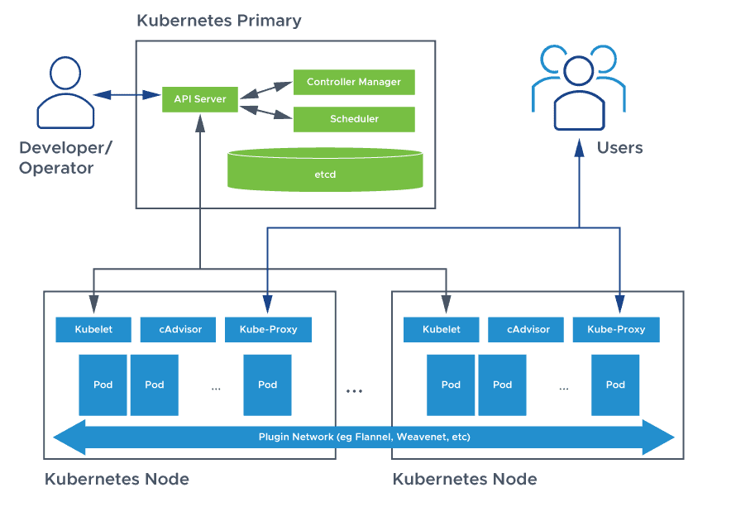
Design of Project
Deploy microservices on kubernetes cluster and improve scalability using custom scheduler

Slide 6
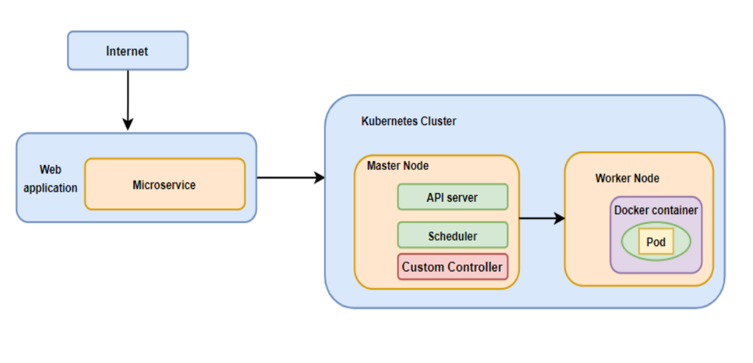
Deploy microservices on kubernetes cluster and improve scalability using custom scheduler
To the kubernetes control plane above, an extra component called the custom controller will be implemented to determine the number of pods to be scheduled for the microservice.
Communicate with other components of control plane via api calls to change the state of the data plane.

Slide 7
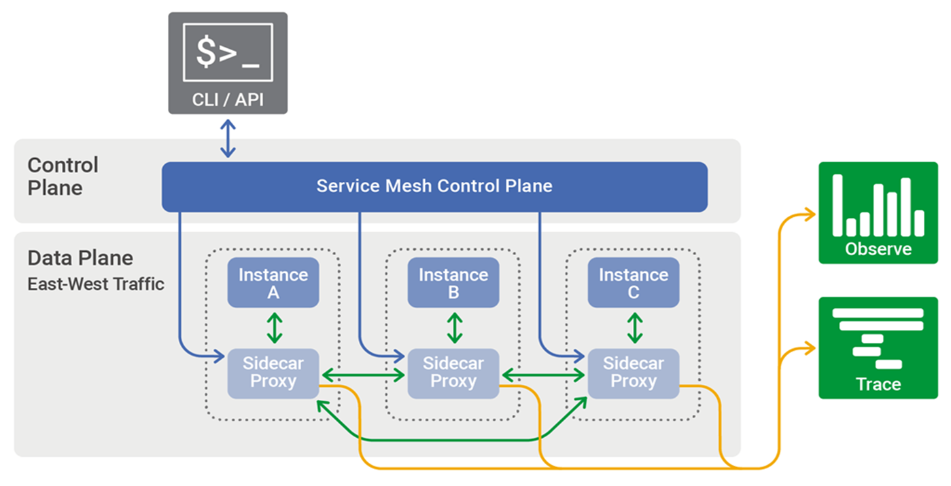
Deploy microservices on kubernetes cluster and improve scalability using custom scheduler
Istio injects envoy proxies and collects metric
Prometheus and grafana use the data from envoy proxies and represent in graphical format and visual representation

Slide 8
Deploy microservices on kubernetes cluster and improve scalability using custom scheduler
Advantages and disadvantages of the proposed approach
Benefits:
Reduces the number of pods allocated
Optimize the cpus usage
Gives more control over the the resources
Drawbacks:
Implementing a new entity ie, custom scheduler in the master node adds complexity.
Platform becomes more complicated when multiple solutions are integrated (scaling and optimal cpu utilization – custom scheduler and security and metric monitoring – istio service mesh).

Slide 9
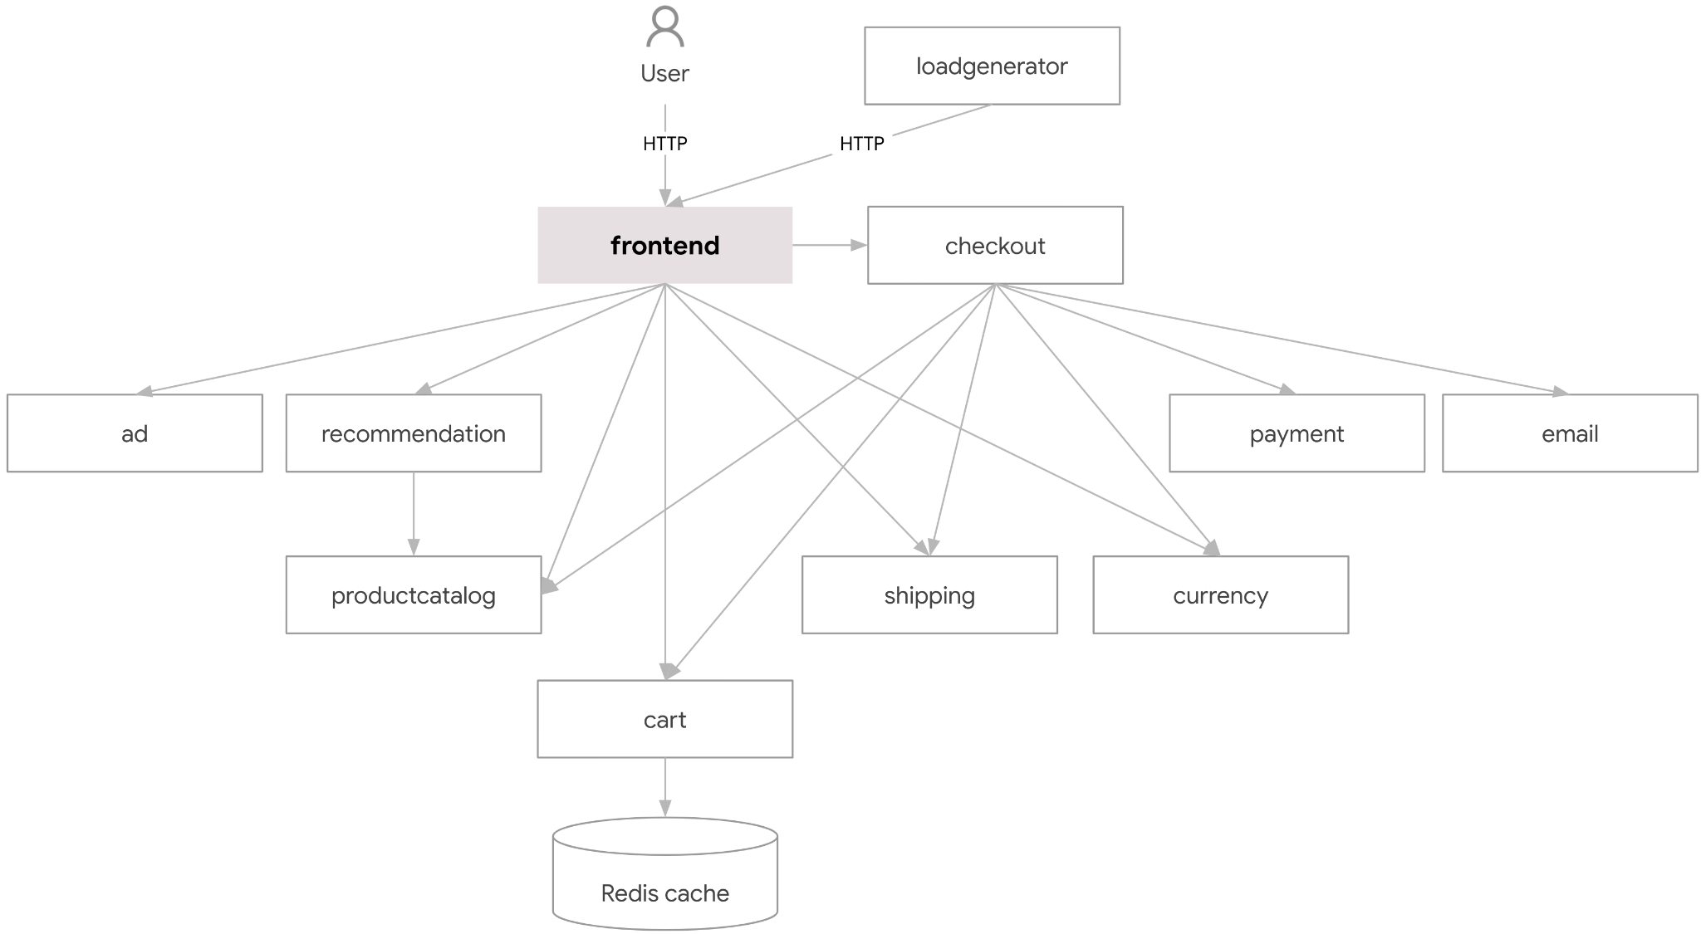
Deploy microservices on kubernetes cluster and improve scalability using custom scheduler
Design Approach
Deployment Diagrams
Deploying e-commerce applications on kubernetes cluster

Slide 10
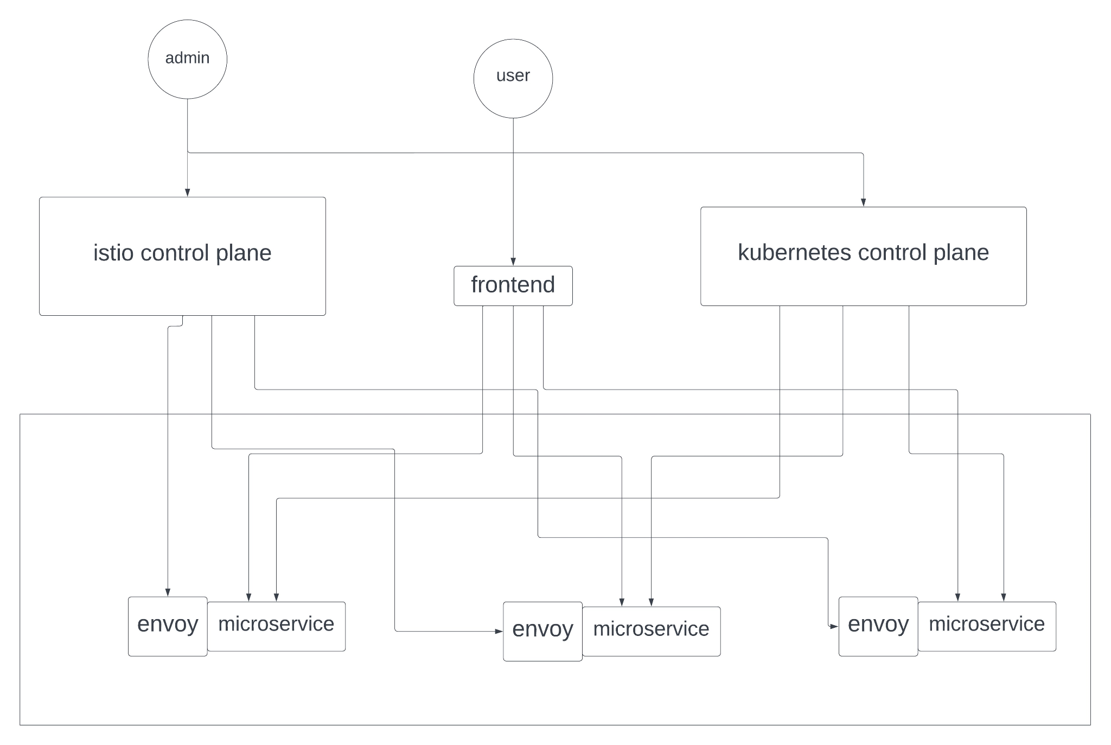
Deploy microservices on kubernetes cluster and improve scalability using custom scheduler
Final deployment architecture

Slide 11
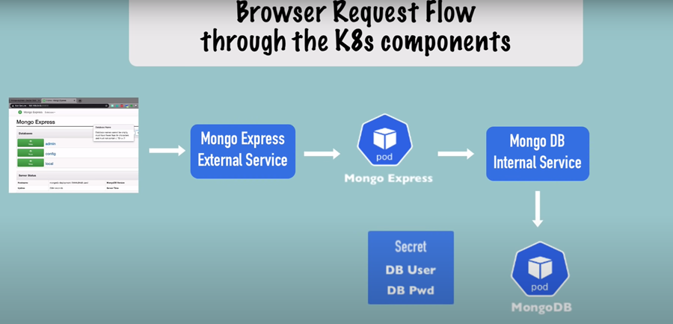
Deploy microservices on kubernetes cluster and improve scalability using custom scheduler
Deploying sample application on EOX-server instance

Slide 12
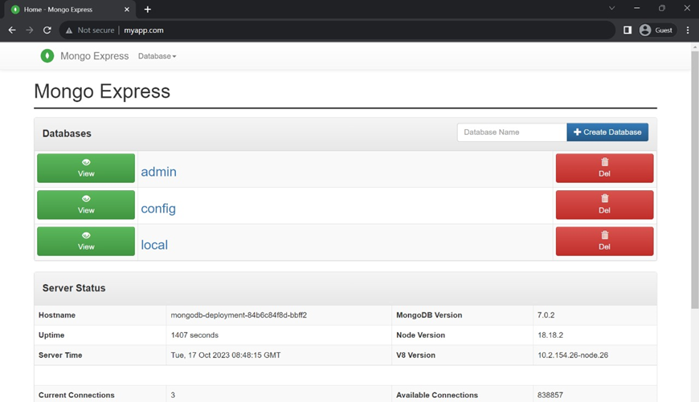
Deploy microservices on kubernetes cluster and improve scalability using custom scheduler

Slide 13
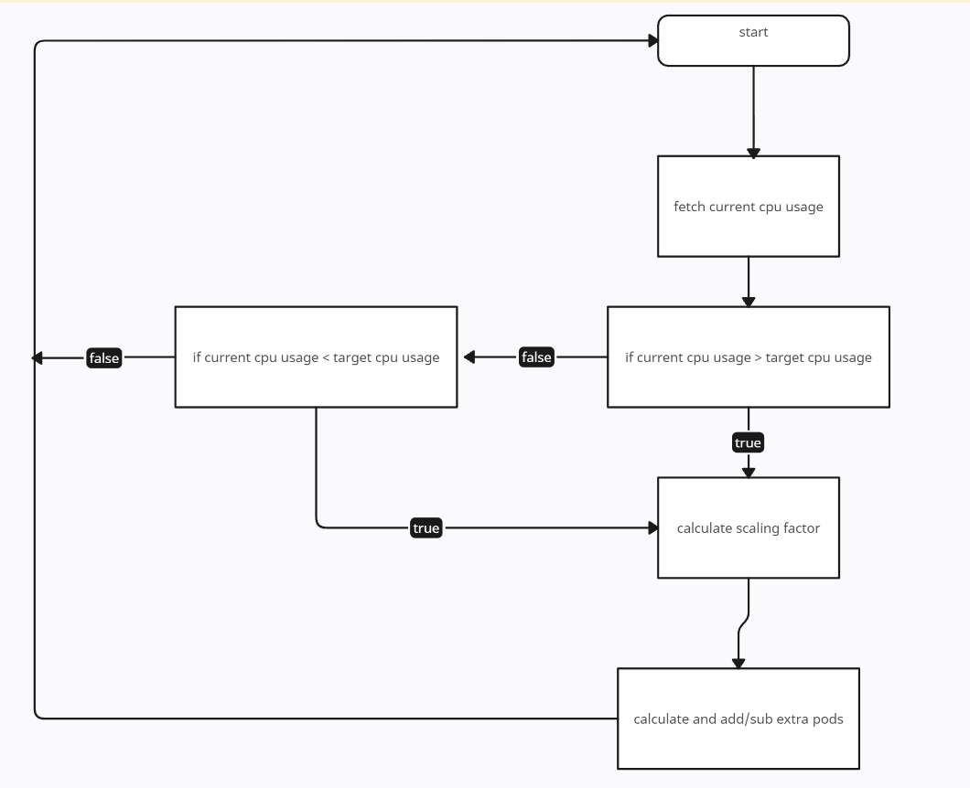
Deploy microservices on kubernetes cluster and improve scalability using custom scheduler
Design Description
Implementation of custom controller: logical workflow

Slide 14
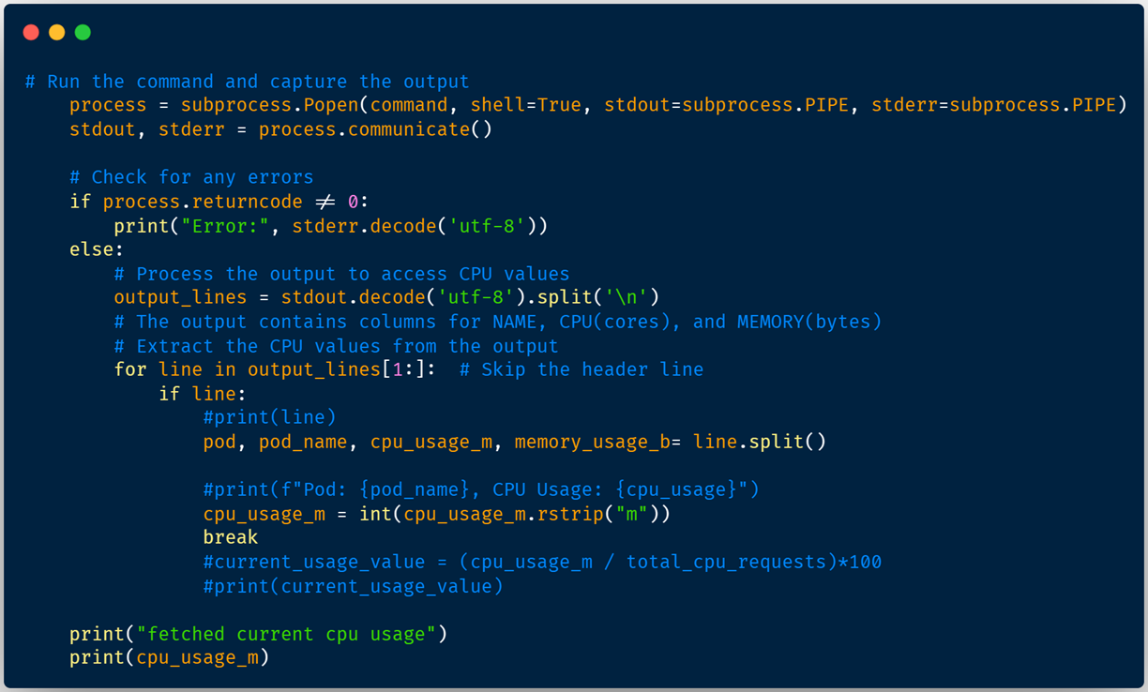
Deploy microservices on kubernetes cluster and improve scalability using custom scheduler
Code Snippets

Slide 15
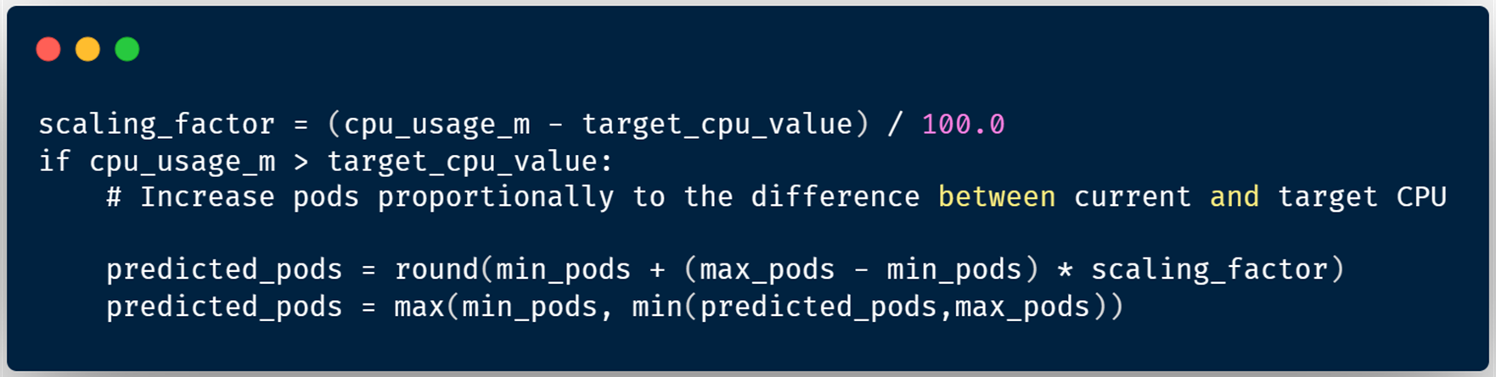
Deploy microservices on kubernetes cluster and improve scalability using custom scheduler
Scaling Algorithm

Slide 16
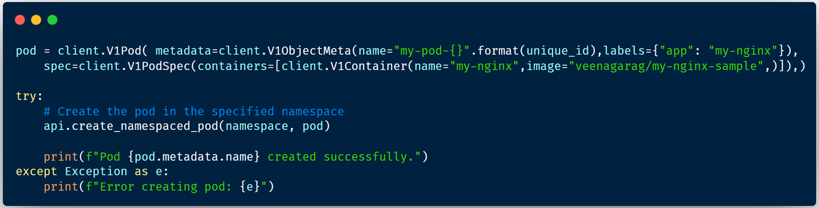
Deploy microservices on kubernetes cluster and improve scalability using custom scheduler
Code Implementation

Slide 17
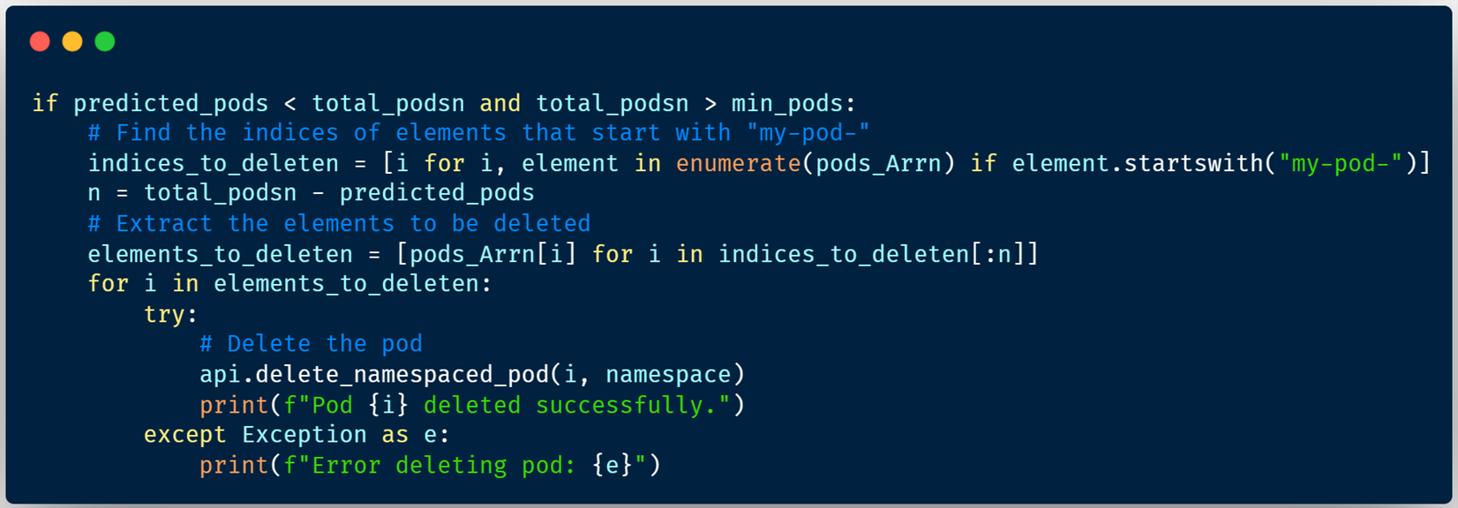
Deploy microservices on kubernetes cluster and improve scalability using custom scheduler
Code Implementation

Slide 18
Test Plan and Strategy
Deploy microservices on kubernetes cluster and improve scalability using custom scheduler
Testing and Validation: Conducted testing to validate the auto-scaling functionality and performance. Employed unit tests, and load tests to ensure the auto-scaler can effectively scale the application under various load conditions.
Deployment and Monitoring: Deploy the auto-scaler to the local environment and monitor its performance closely. Continuously evaluate the auto-scaler's effectiveness in handling workload fluctuations and maintaining application performance.

Slide 19
Deploy microservices on kubernetes cluster and improve scalability using custom scheduler
using locust requests are swarmed, in 2, 8, 15 min time frames:
I. 3000 users and 600 rps
II. 200 users and 50 rps,
and observed for the number of pods allocated by the algorithms
locust
kubernetes cluster
metric monitoring
Veena_Adarsh_Suchit_Yuvaraj

Slide 20
Results and Discussion
Deploy microservices on kubernetes cluster and improve scalability using custom scheduler
The project successfully implemented a custom controller auto-scaler, enabling dynamic scaling of the microservices-based application.
Through a comparative analysis of the Horizontal Pod Autoscaler (HPA) algorithm and our custom controller, our algorithm demonstrated superior performance compared to the default algorithm. This enhanced efficiency resulted in improved resource utilization and application responsiveness.

Slide 21
Result and discussion
Deploy microservices on kubernetes cluster and improve scalability using custom scheduler
Algorithm Used(for 3000 users, 600 rps) | KHPA | Custom Scheduler
2 | 9 | 2
8 | 10 | 3
15 | 10 | 5
Algorithm Used(for 200 users, 50 rps) | KHPA | Custom Scheduler
2 | 10 | 1
8 | 5 | 1
15 | 1 | 1

Slide 22
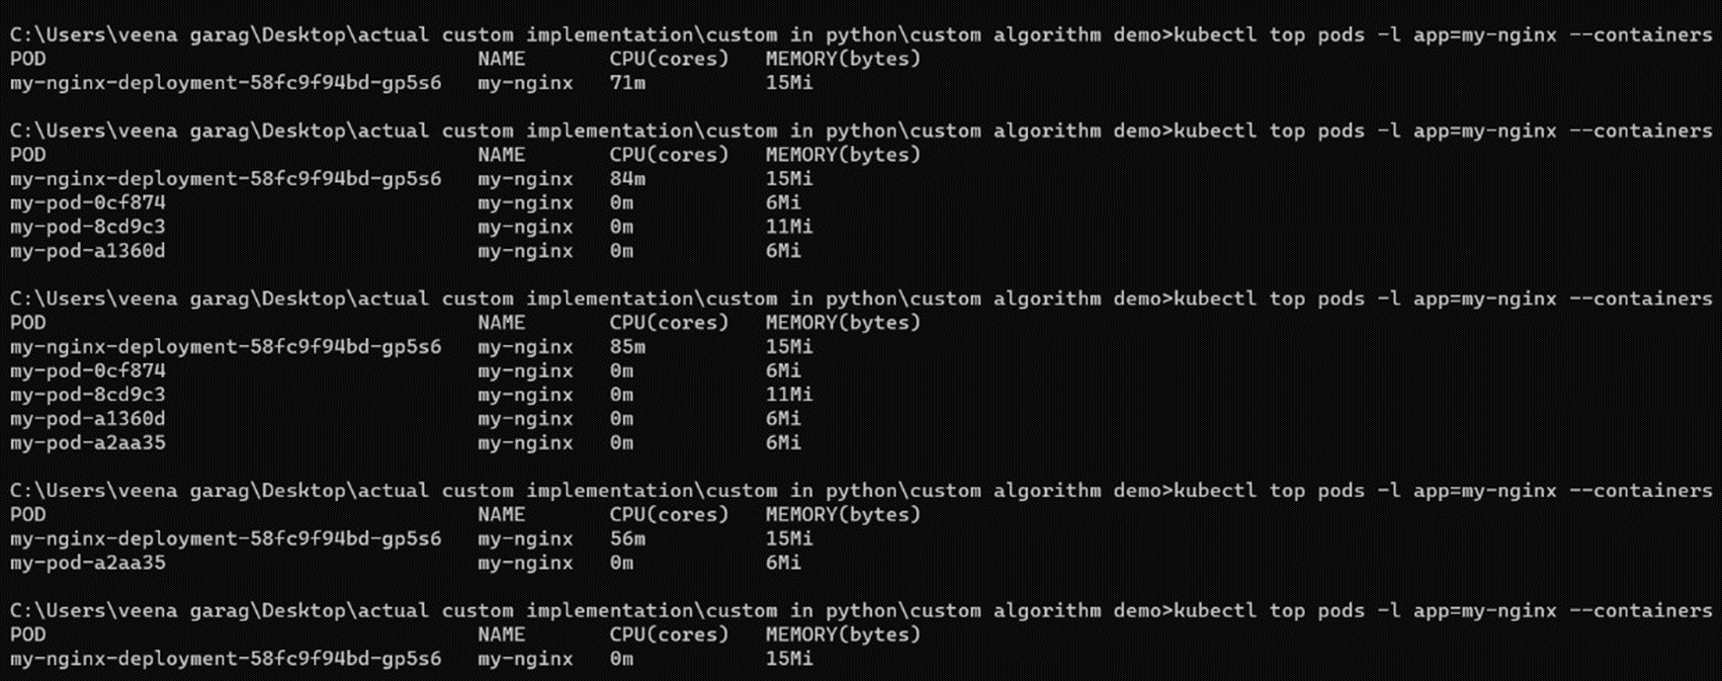
Deploy microservices on kubernetes cluster and improve scalability using custom scheduler
Project Demonstration

Slide 23
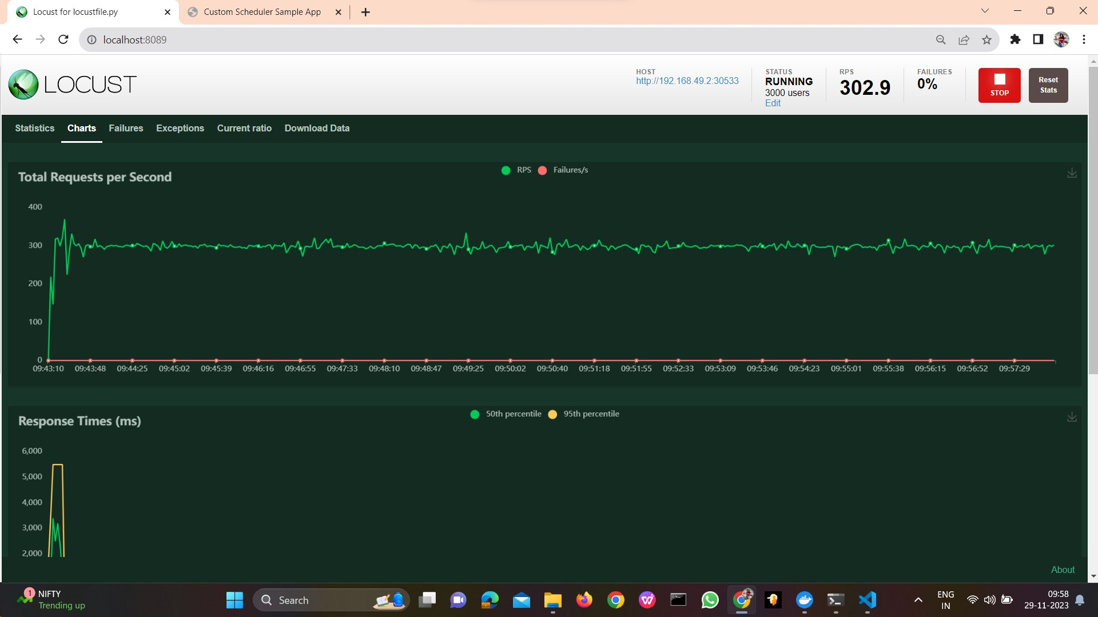
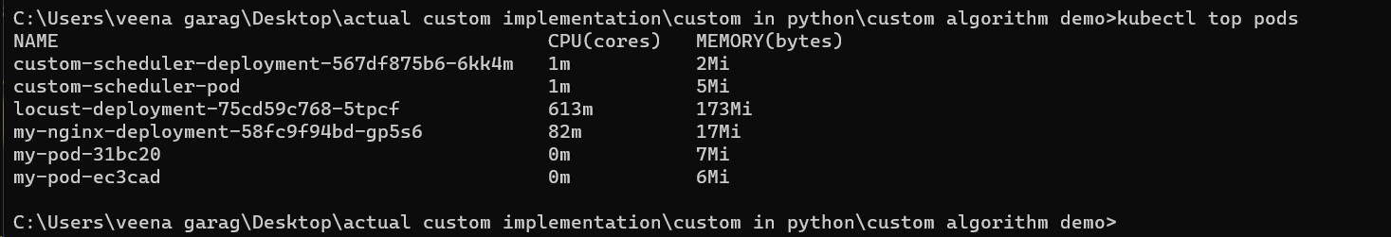
Deploy microservices on kubernetes cluster and improve scalability using custom scheduler
Generation of load by 3000 users with 600 rps
Pod creation using custom scheduler during the first 2 minutes window

Slide 24
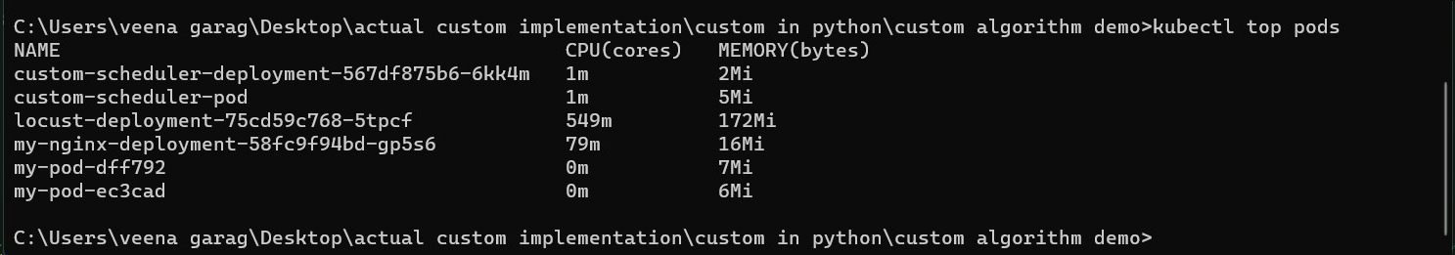
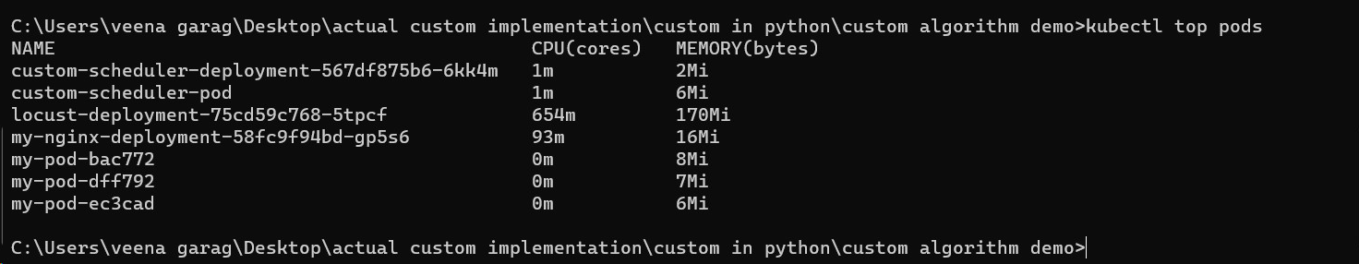
Deploy microservices on kubernetes cluster and improve scalability using custom scheduler
Pod creation using custom scheduler during the first 8 minutes window
Pod creation using custom scheduler during the first 15 minutes window

Slide 25
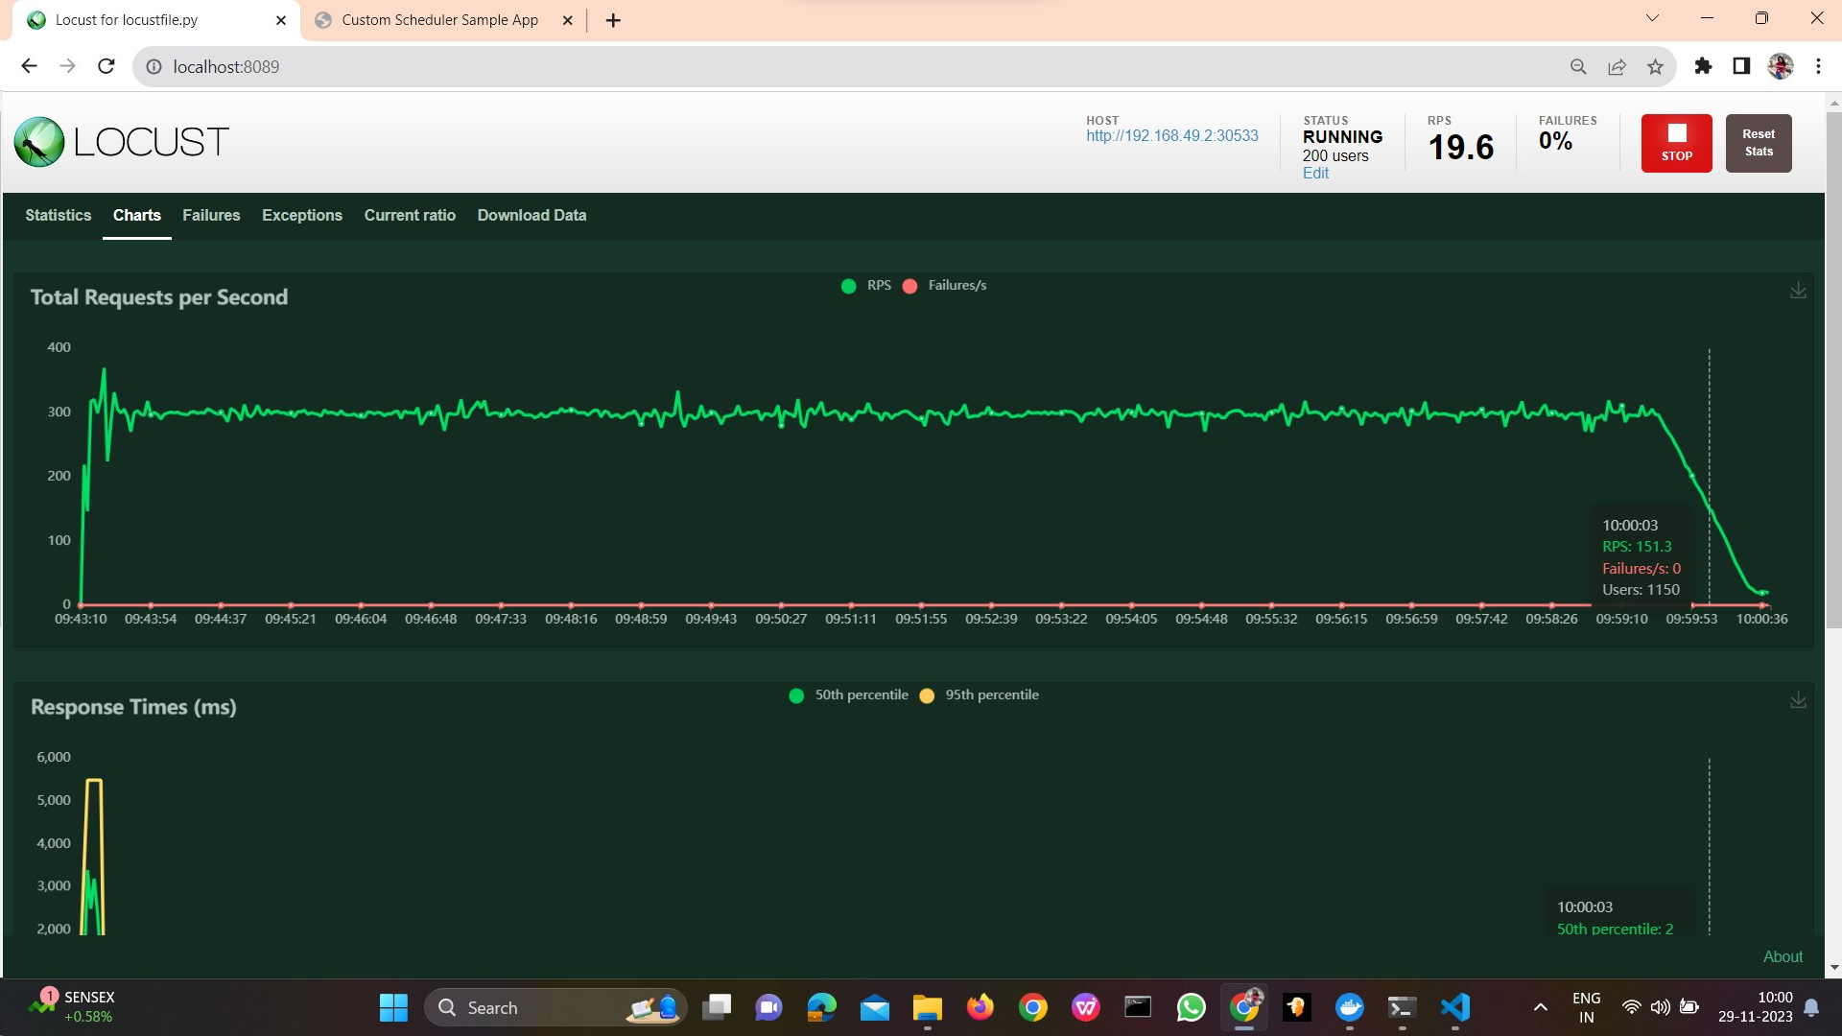
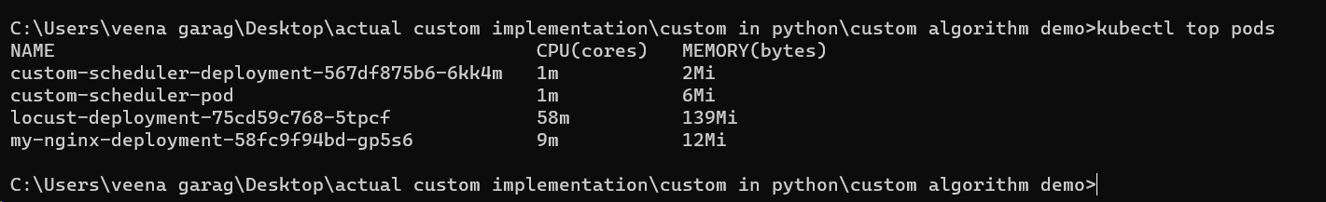
Deploy microservices on kubernetes cluster and improve scalability using custom scheduler
Generation of load by 200 users 100 rps
The number of pods decreased when the load is decreased

Slide 26
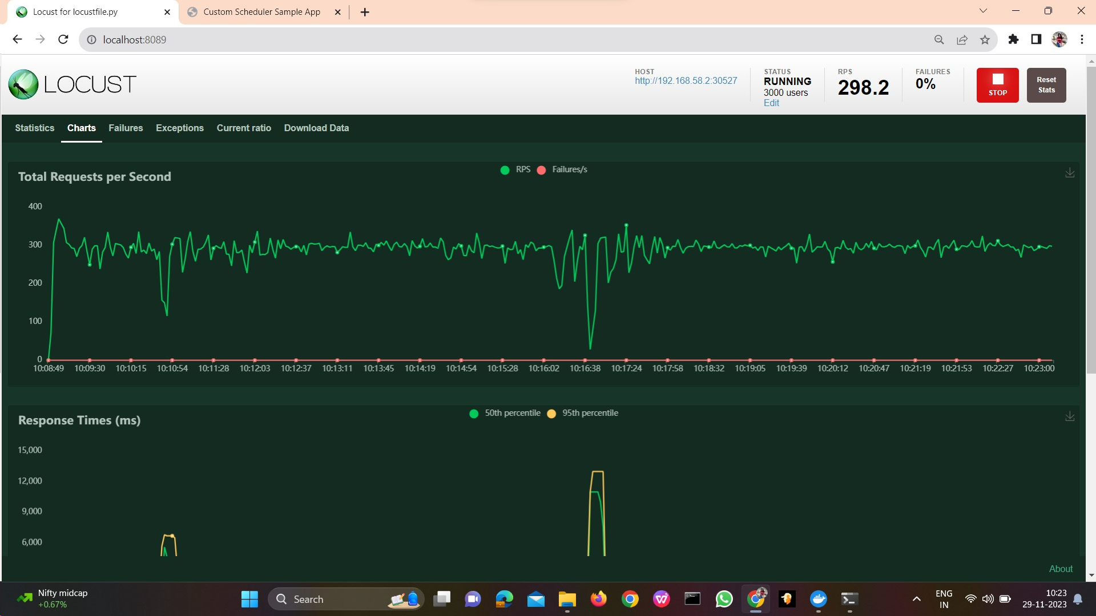
Deploy microservices on kubernetes cluster and improve scalability using custom scheduler
Demonstration of working of KHPA
Load generation of 3000 users with 600 rps
Creation of replicas by KHPA based on increase of load during 2 minutes time frame

Slide 27
Deploy microservices on kubernetes cluster and improve scalability using custom scheduler
Creation of replicas by KHPA based on increase of load during 8 minutes time frame.
Creation of replicas by KHPA based on increase of load during 15 minutes time frame

Slide 28
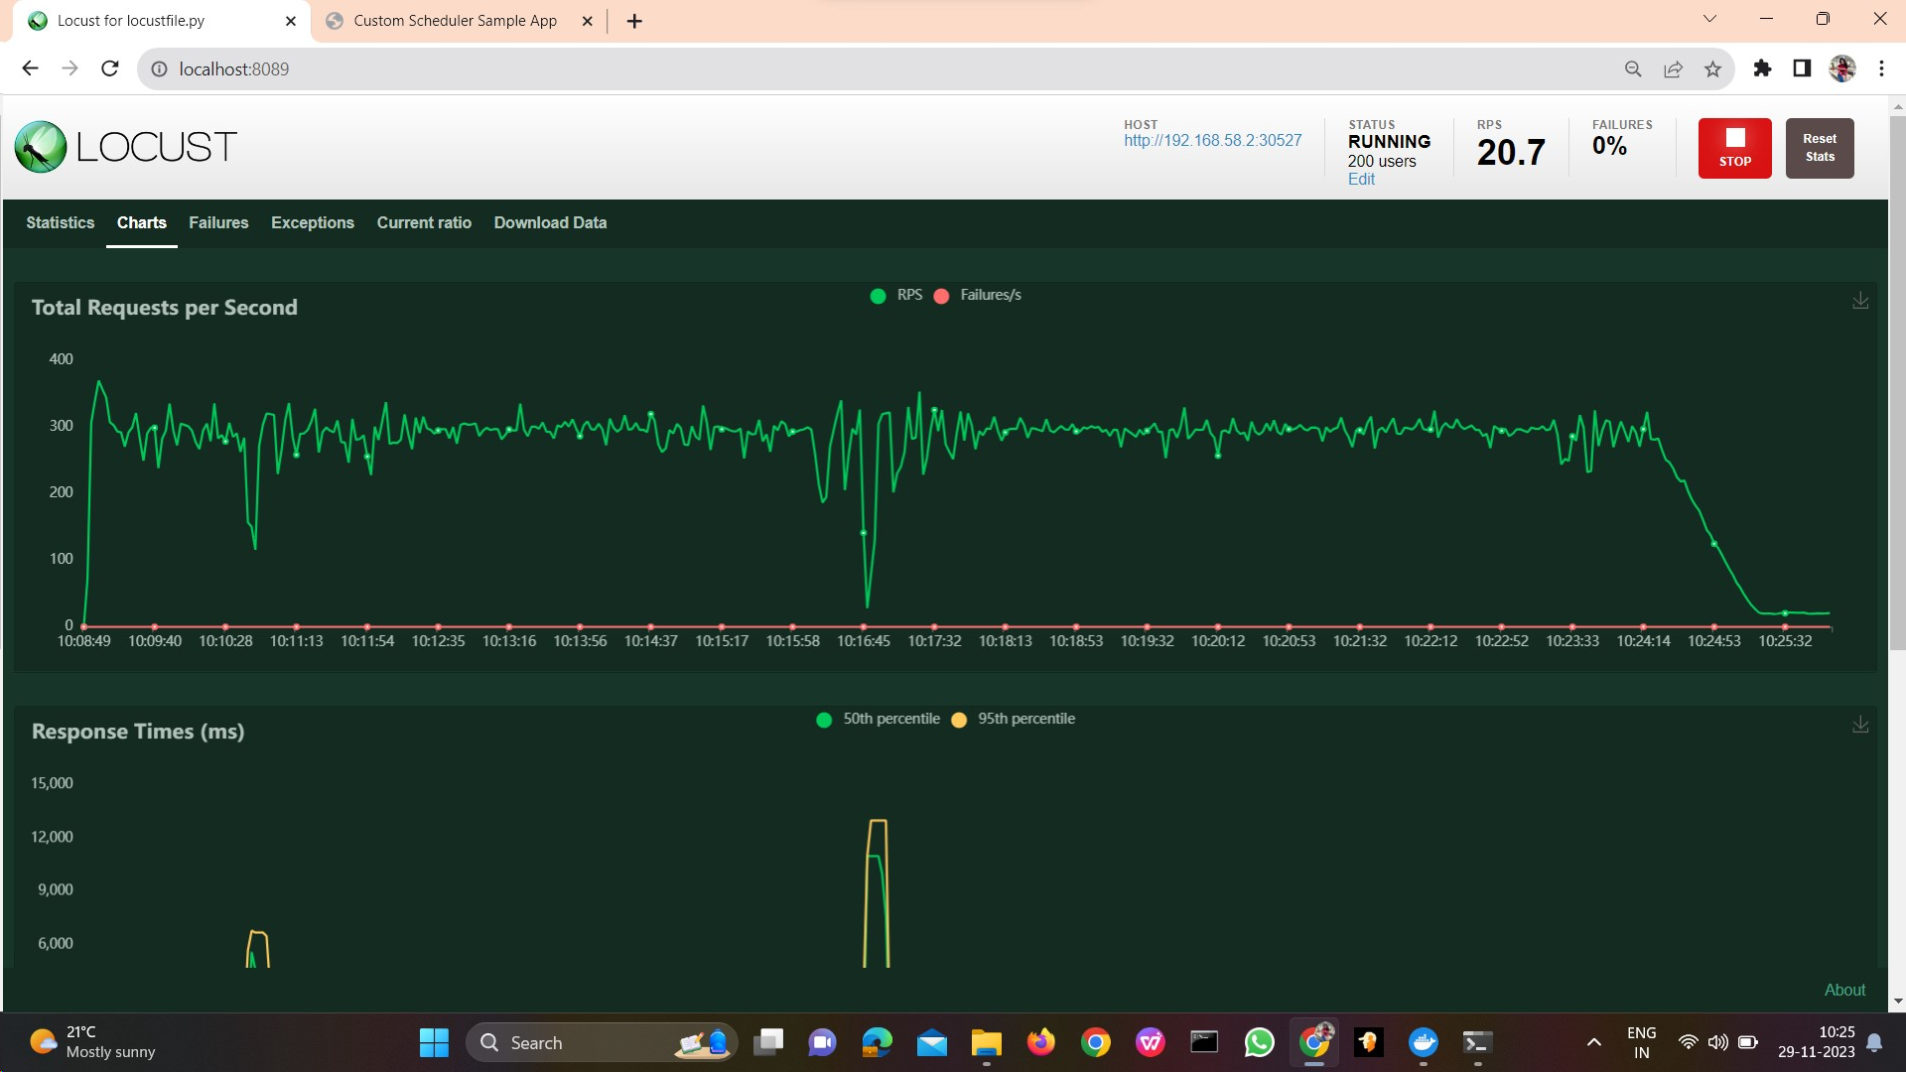
Deploy microservices on kubernetes cluster and improve scalability using custom scheduler
Generation of load by 200 users 100 rps
The number of pods when the load is decreased

Slide 29
Conclusion
Deploy microservices on kubernetes cluster and improve scalability using custom scheduler
The project successfully implemented a custom controller auto-scaler within a Kubernetes environment to dynamically scale a microservices-based application. This approach ensure optimal performance under varying load conditions.
The project utilizes Istio mesh networks to enhance service-to-service communication and visibility. Kailali and Prometheus are employed for comprehensive monitoring of services, while Grafana provides a centralized dashboard for visualizing and analysing key metrics.

Slide 30
Future Work
Deploy microservices on kubernetes cluster and improve scalability using custom scheduler
Support for other metrics: In addition to CPU usage, we could also consider supporting other metrics, such as memory usage, network traffic, or response time. This would give us more granular control over how your scheduler scales our microservices.
Predictive scaling: Instead of reacting to current CPU usage, we could use predictive scaling to anticipate future load and scale our microservices accordingly. This could help to avoid performance bottlenecks and improve overall scalability. This could be done using machine learning to train a model on historical CPU usage data.
Integrate with CI/CD pipelines: This would allow us to automatically deploy our custom scheduler to your Kubernetes cluster. We could also use CI/CD pipelines to collect feedback on the performance of your scheduler and to make improvements over time.

Slide 31
Deploy microservices on kubernetes cluster and improve scalability using custom scheduler
References
Deshpande, Neha (2021) Autoscaling Cloud-Native Applications using Custom Controller of Kubernetes.
https://norma.ncirl.ie/5089/
Masters thesis, Dublin, National College of Ireland.
Shitole, Abhishek Sanjay (2022) Dynamic Load Balancing of Microservices in Kubernetes Clusters using Service Mesh.
https://norma.ncirl.ie/5943/
Masters thesis, Dublin, National College of Ireland.
Nandan Adhikari (April 19, 2021) Horizontal Pod Autoscaler in Kubernetes https://around25.com/blog/horizontal-pod-autoscaler-in-kubernetes/
An Efficient and Scalable Traffic Load Balancing Based on Web Server Container Resource Utilization using Kubernetes Cluster.(May – 2022) Ashok L Pomnar,
AVCOE Sangamner 422 605,Maharashtra, India.
https://ijisrt.com/assets/upload/files/IJISRT22MAY1644_(1)_(1).pdf
V. Sharma, "Managing Multi-Cloud Deployments on Kubernetes with Istio, Prometheus and Grafana," 2022 8th International Conference on Advanced Computing and Communication Systems (ICACCS), Coimbatore, India,
https://doi.org/10.1109/ICACCS54159.2022.9785124

Slide 32
Deploy microservices on kubernetes cluster and improve scalability using custom scheduler
Thank You

